Slide 1
NHERI GSC General Meeting September

Slide 2
Agenda
12:00-12:05 Introduction/Announcements
12:05-12:25 Tricia Clayton, Wake Forest University
12:25-12:55 Research Breakout Rooms
12:55-1:00 Wrap-up

Slide 3
WELCOME NEW MEMBERS
Mohamed Eissa
Benjamin Roston
Taylor Lightner
Zahra Nourali
Esmail Shahrokhinasab
Carmen Atkins
Abdul Khan
Julie Elliott

Slide 4
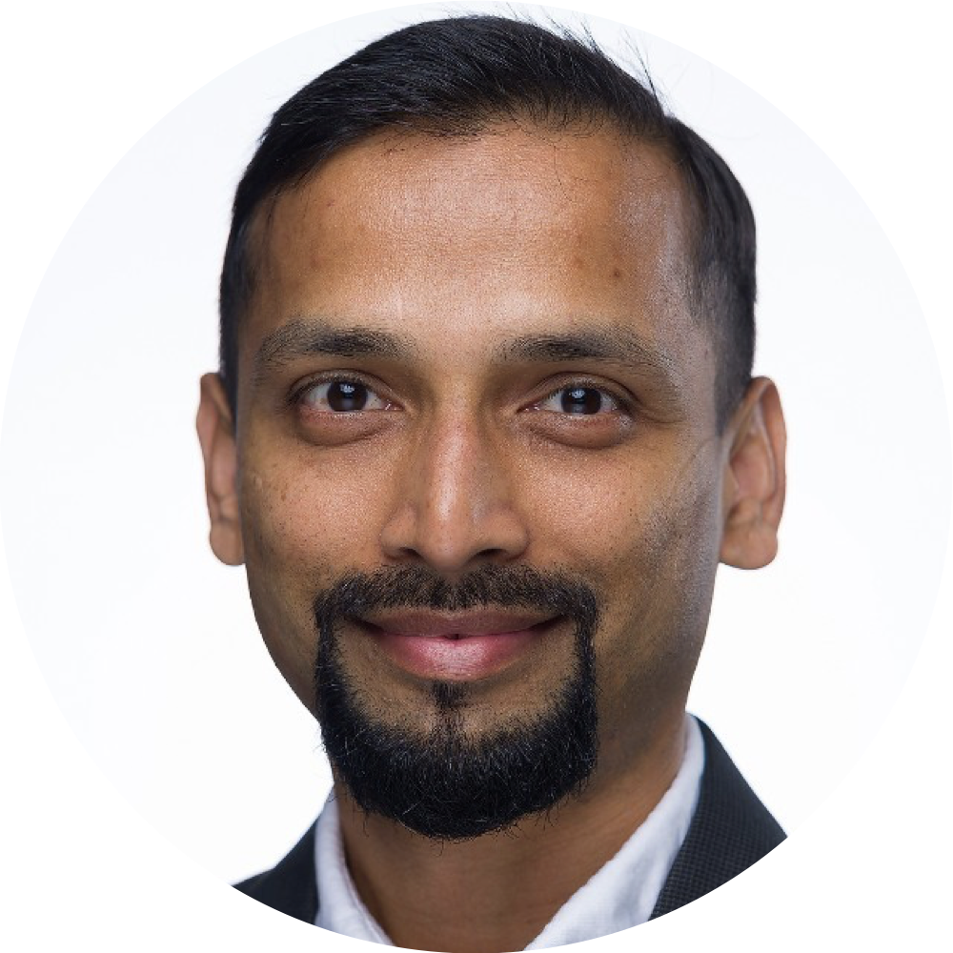
CONGRATULATIONS
Rakesh Salunke
Vice-Chair of Research

Slide 5
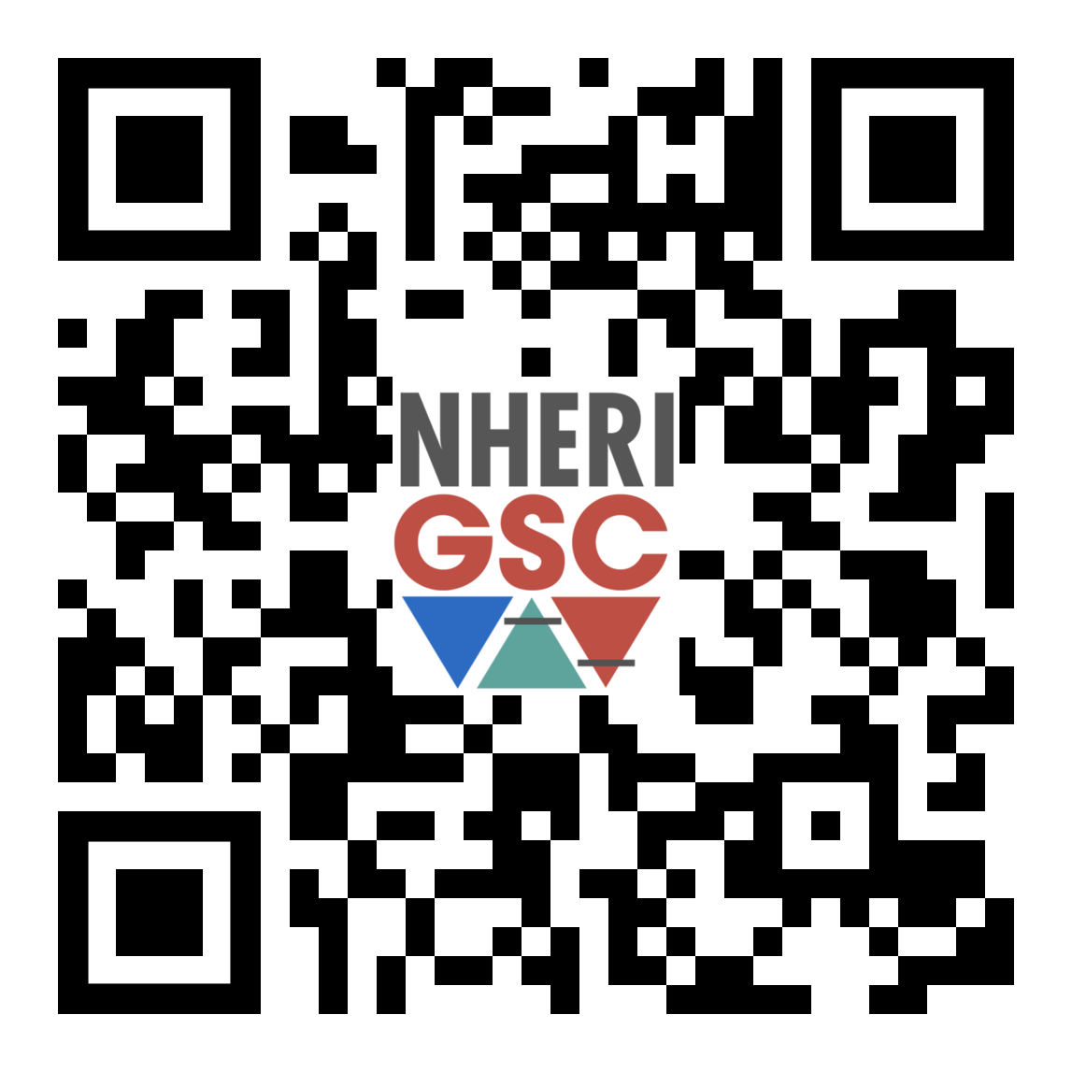
Natural Hazards Research Summit NHERI GSC Session
Science Plan, Setting Research Agenda
Publishing Best Practices
H&I Indices, Conferences, and Journals
Publishing of Data
Peer Review, Rejection
https://bi
https://bit.ly/NHERI_GSC_Session

Slide 6
To add events to our NHERI GSC calendars please email our communications team:
Niko Todorov todorov@chapman.edu
Edwin Rajeev edwinrajeev@ufl.edu
NHERI GSC Conference Calendar
NHERI GSC Workshop & Events Calendar
bit.ly/NHERI_GSC_ConferenceCalendar
bit.ly/NHERI_GSC_WorkshopsEventsCalendar

Slide 7
Join us for NHERI GSC DEI workshop
Sept
23
11 a.m. – 1 p.m. CST
Learn about how to ensure that researchers consider diversity, equity, and inclusion in natural hazards
Sign up here and BOLO for email links.
Notes:
https://designsafe-ci.zoom.us/meeting/register/tJwufuqqqzIvGtccud5YOr45cD5P181IQnwa

Slide 8
Register for NATURAL HAZARDS RESEARCH SUMMIT 2022
October
6-7
Washington, DC
https://www.designsafe-ci.org/learning-center/training/nco/2022/natural-hazards-engineering-research-summit/overview/
Notes:
https://designsafe-ci.zoom.us/meeting/register/tJwufuqqqzIvGtccud5YOr45cD5P181IQnwa

Slide 9
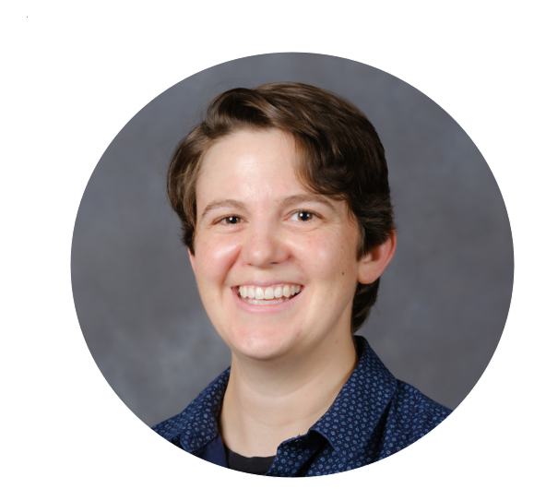
Tricia Clayton
Associate Professor at
Wake Forest University
Notes:
Tricia Clayton, Associate Professor Wake Forest University will be talking on mobile shakers.

Slide 10
Breakout Rooms (BR)
Please select a research area to participate.
Join the Research BR room that you are most interest in participating.
Earthquake
Wind
Tsunami
Coastal Engineering
Cyberinfrastructure
Simulation/Computational Modeling
Reconnaissance
Social Science

Slide 11
Monthly Research Workshop Poll
Please share in chat which topic you would like to learn more about.
DesignSafe:
Field Images, Machine Learning, and Artificial Intelligence
Geohazard Modeling
Hurricanes and Windstorm Modeling
Seismic Modeling
SimCenter:
Earthquake Engineering
Machine learning and Computer Vision
Regional Disaster Simulation
Structural Performance Assessment
Uncertainty Quantification
Wind Engineering

Slide 12
Future Meeting Dates
3rd Friday of every month at 11:00am
CST
Oct
21

